Slide 1
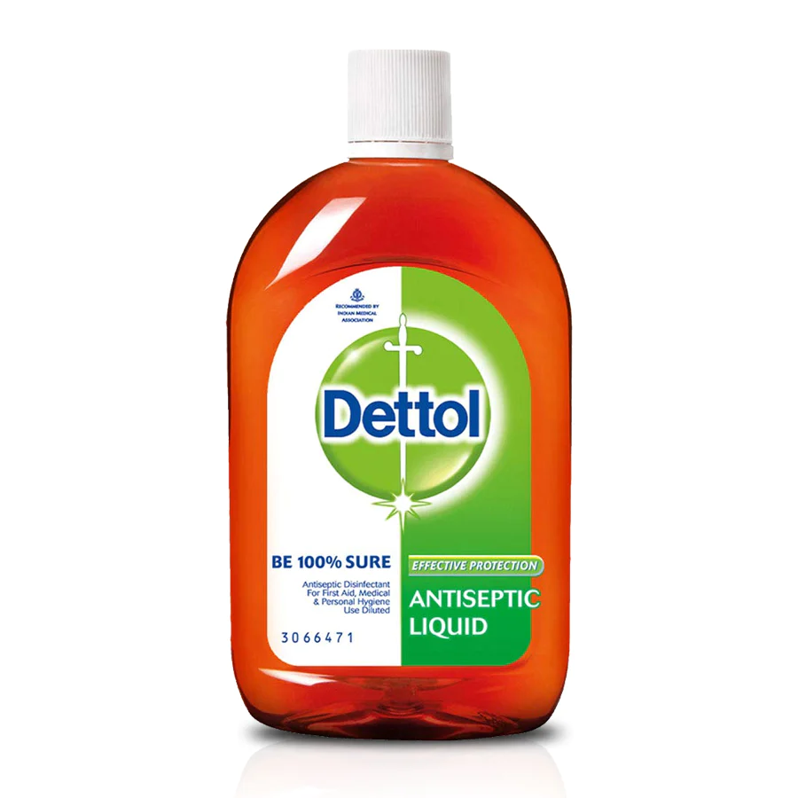

Dettol
-Reckitt Benckiser

Slide 2
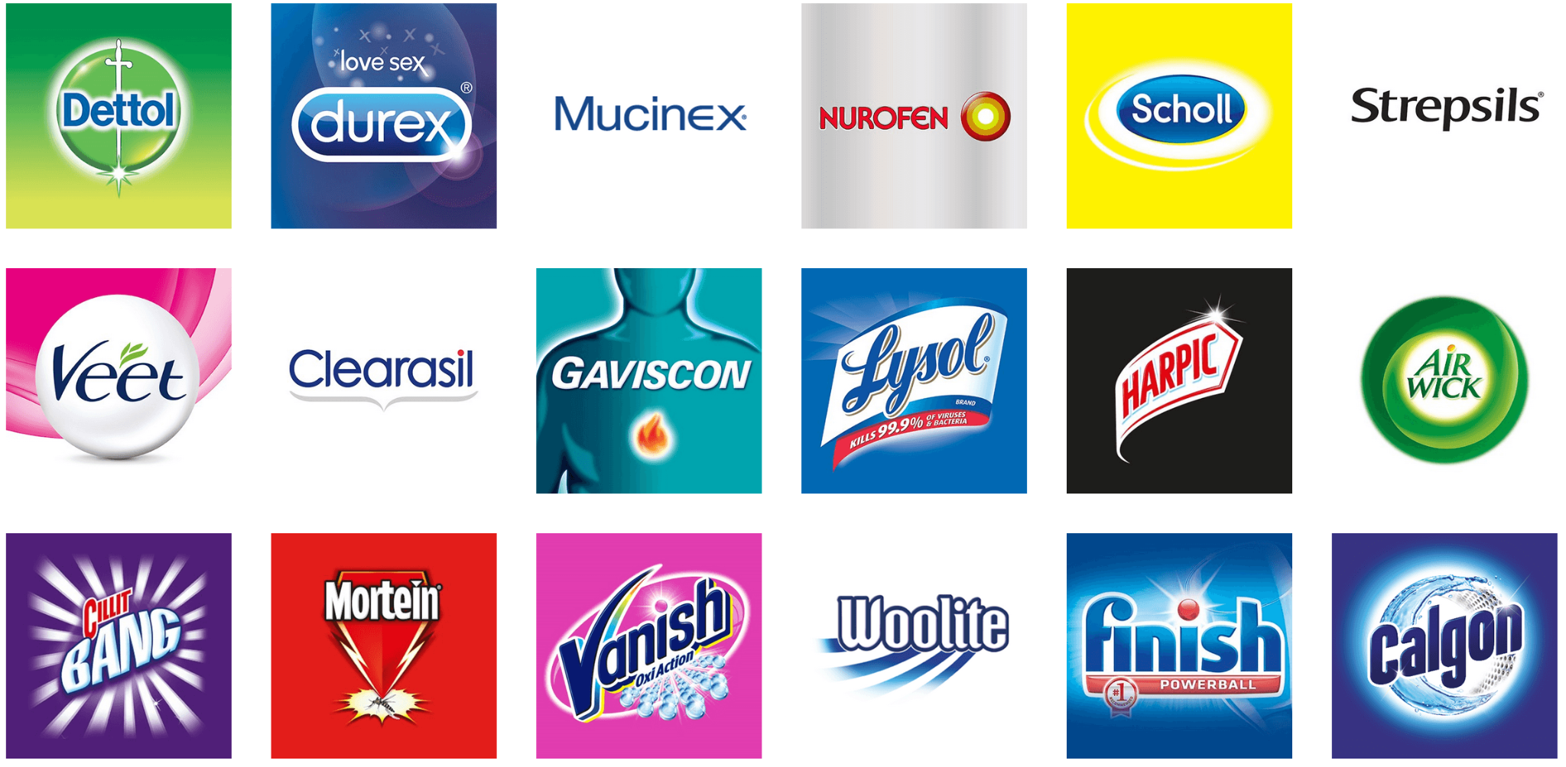
Products of RBIL

Slide 3

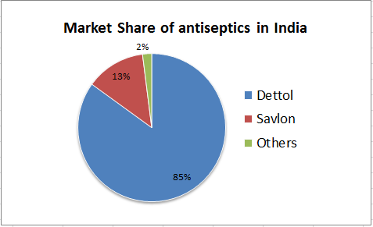
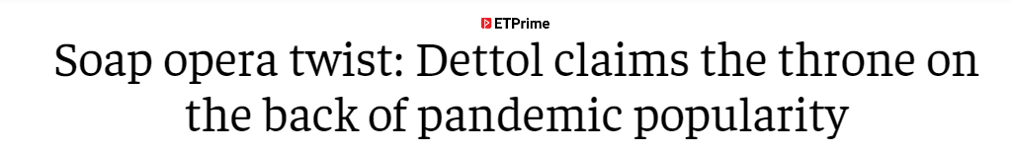

Slide 4
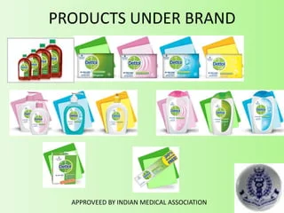
Product Expansion:

Slide 5
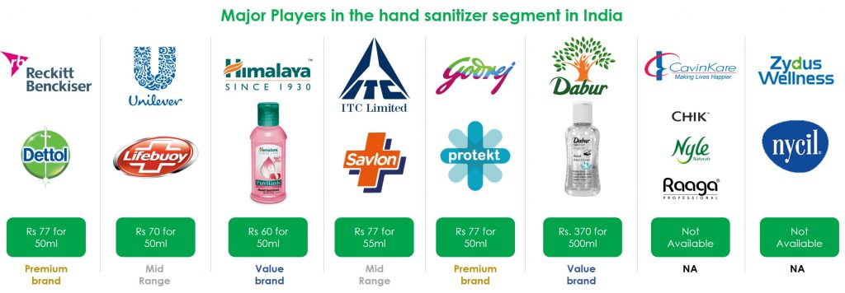
Competitors

Slide 6
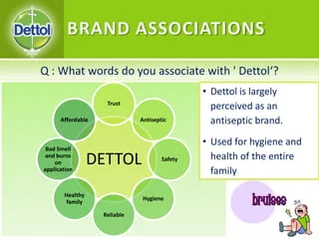
Brand Associations:

Slide 7
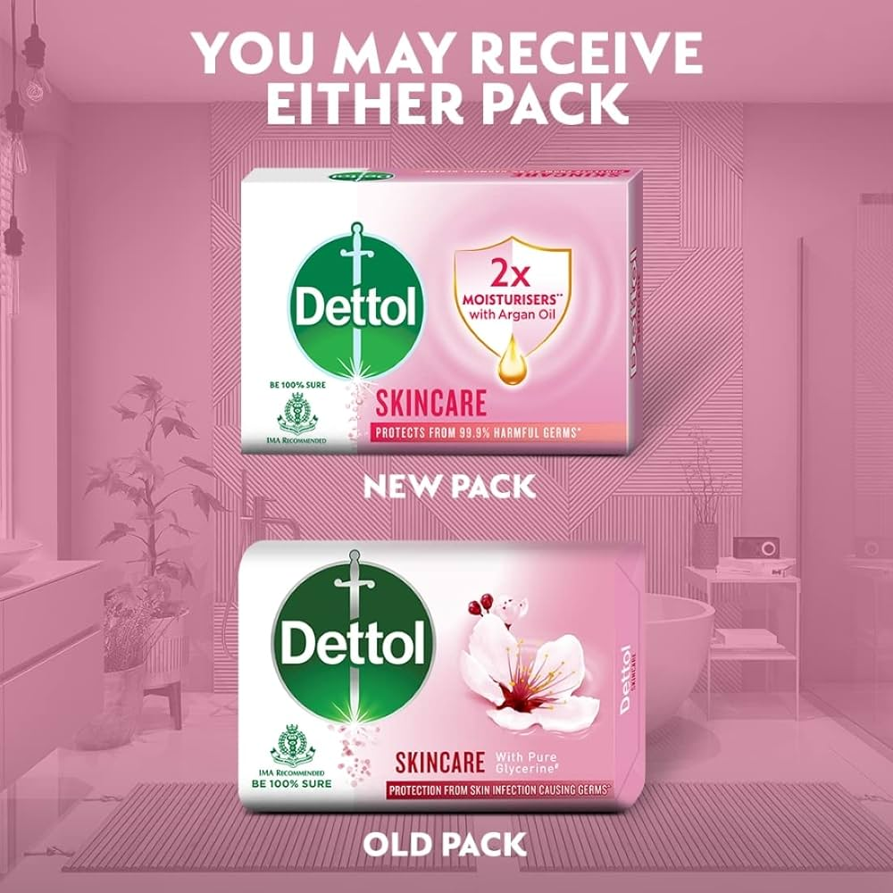
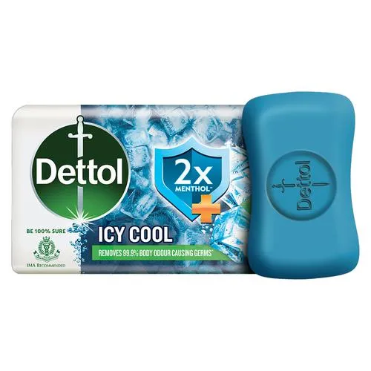
SOAP Market

Slide 8
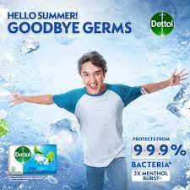
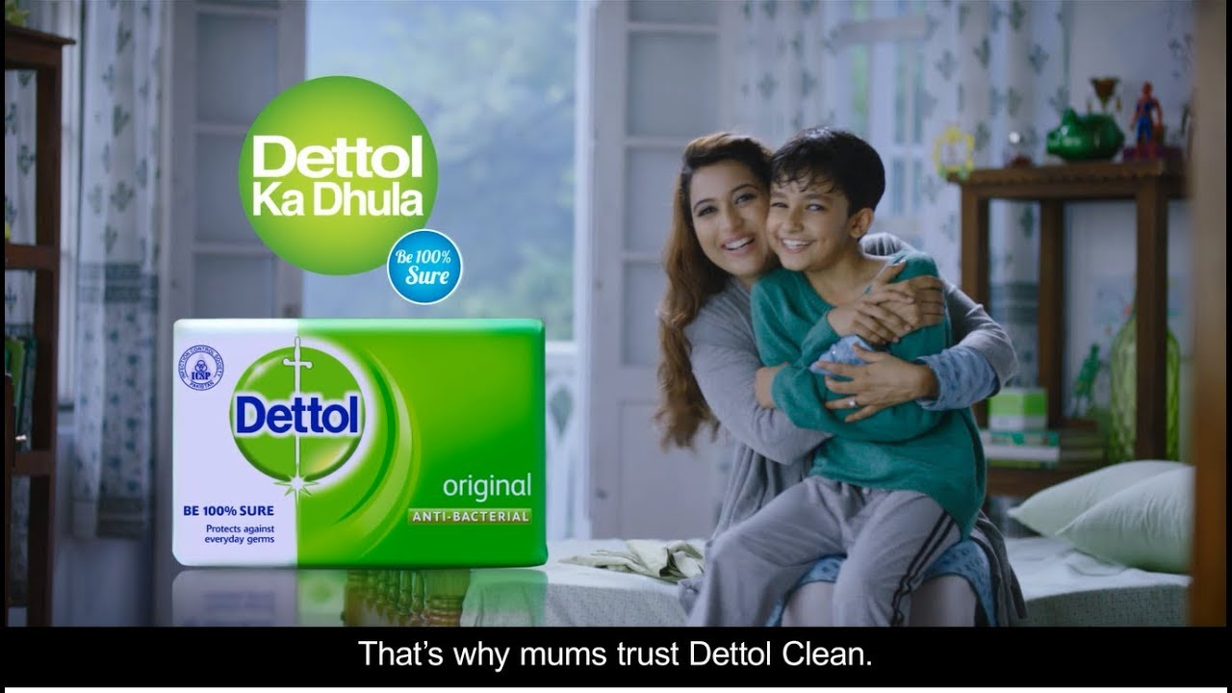
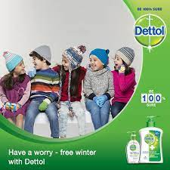
“Aapka Dettol Kya Kya Karta Hai”

Slide 9

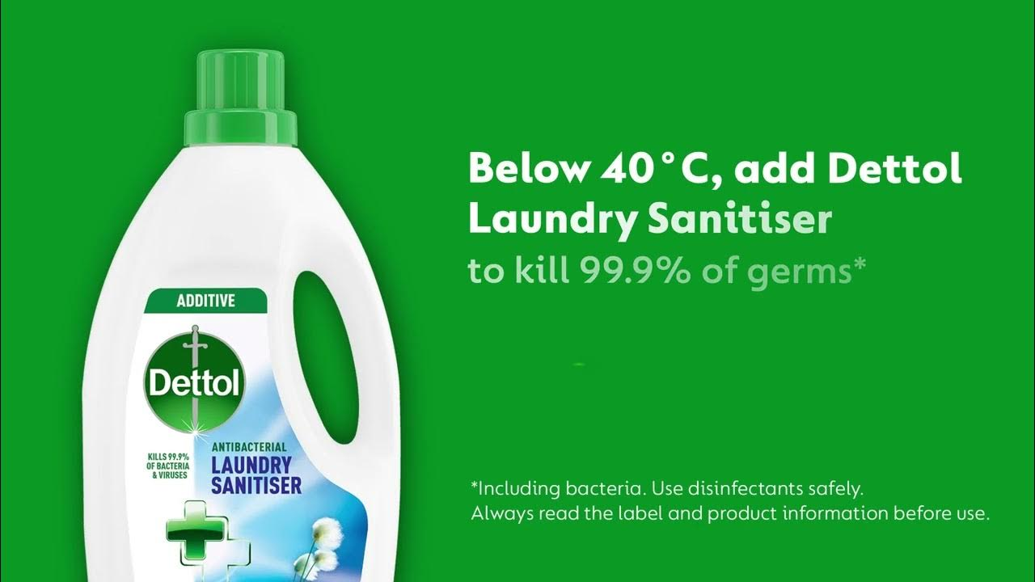
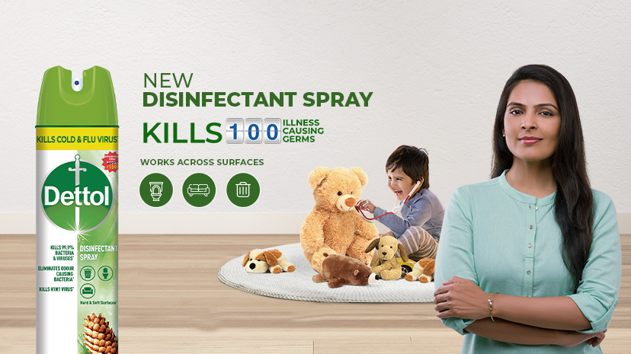
QUANTIFY

Slide 10
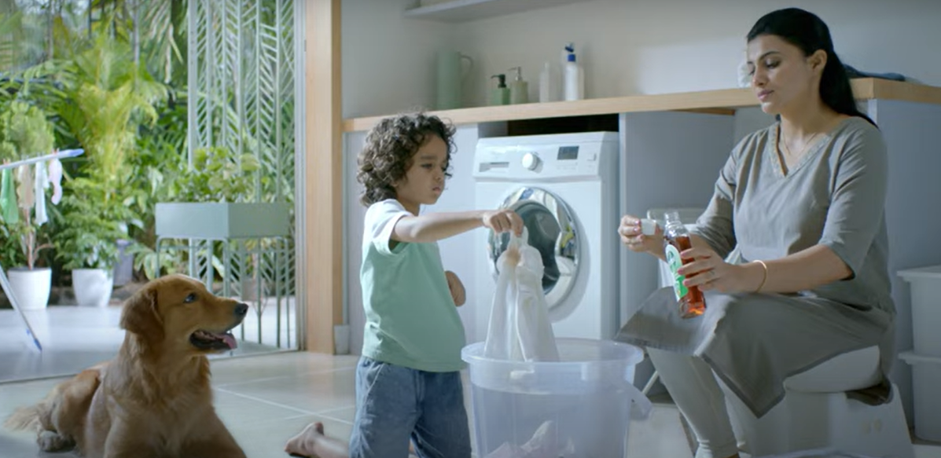
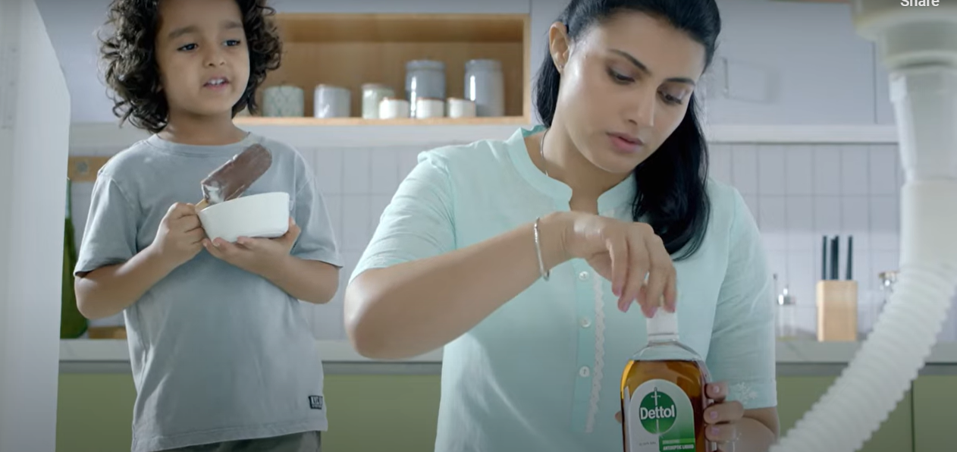
Recent Communication
Educating Consumers.

Slide 11
SWOT
Strengths:
Brand Reputation
Diverse Product Portfolio
Market Leadership
Consumer Trust
Innovation
Weaknesses:
Limited Market Penetration in Some Categories
Seasonal Demand
Premium Pricing
Opportunities:
Growing Health and Hygiene Consciousness
Product Expansion
E-Commerce Expansion
Collaborations for Health Initiatives
Threats:
Intense Competition
Economic Factors
Regulatory Changes
Consumer Perception Shifts

Slide 12
SOLUTION:
Stick to seasonal Market
Original product is the Key
Innovation in Soaps addressing the Seasonal Markets
Innovative product Push.

Slide 13


